Slide 1
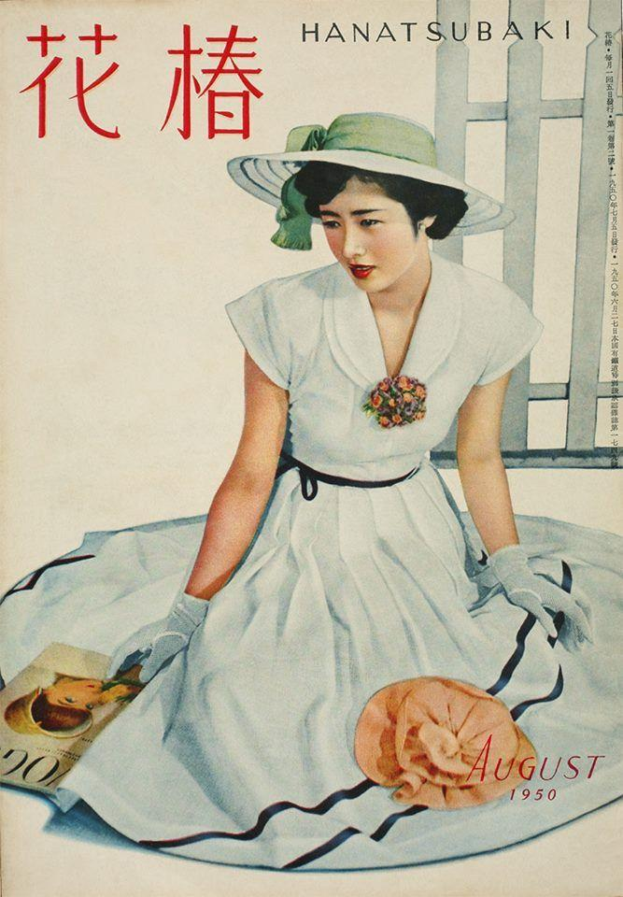
EAST ASIAN MAGAZINES
NAME:M SHRADHA

Slide 2
Contents
POPULAR MAGAZINES FROM CHINA.
POPULAR MAGAZINES FROM JAPAN.
POPULAR MAGAZINES FROM SOUTH KOREA.
POPULAR MAGAZINES FROM NORTH KOREA.

Slide 3
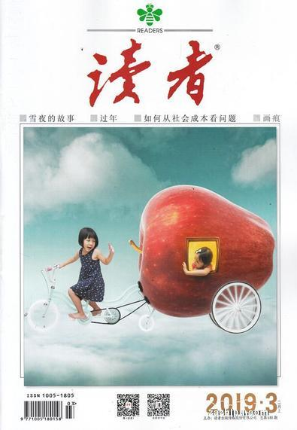
Popular magazines FROM china
DUZLE (READER)
Duzhe (Reader) has long been regarded as the most popular magazine in China so much so it has been called the "Chinese mind reader." Founded in 1981 and sponsored by the Gansu People's Publishing House, it is a general interest magazine that covers various subjects such as stories, celebrity biography, jokes, anecdotes, quotations. It marketed in more than 90 countries and regions in the world. Duzhe is published semi-monthly and has been called both the New Yorker and the Reader’s Digest of China.

Slide 4
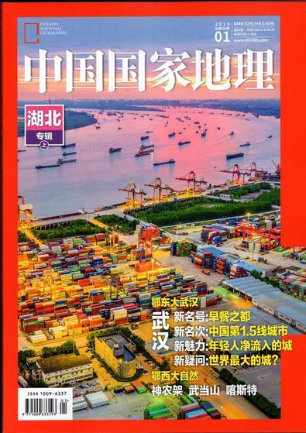
CHINESE NATIONAL GEOGRAPHY
Chinese National Geography is a monthly magazine similar to National Geographic magazine. Launched, in 1949, it is China’s most authoritative geographic publication. The magazine offers in-depth articles covering geography, history and culture, aiming at unraveling the mysteries of China. The magazine is circulated in both English and traditional Chinese editions.

Slide 5
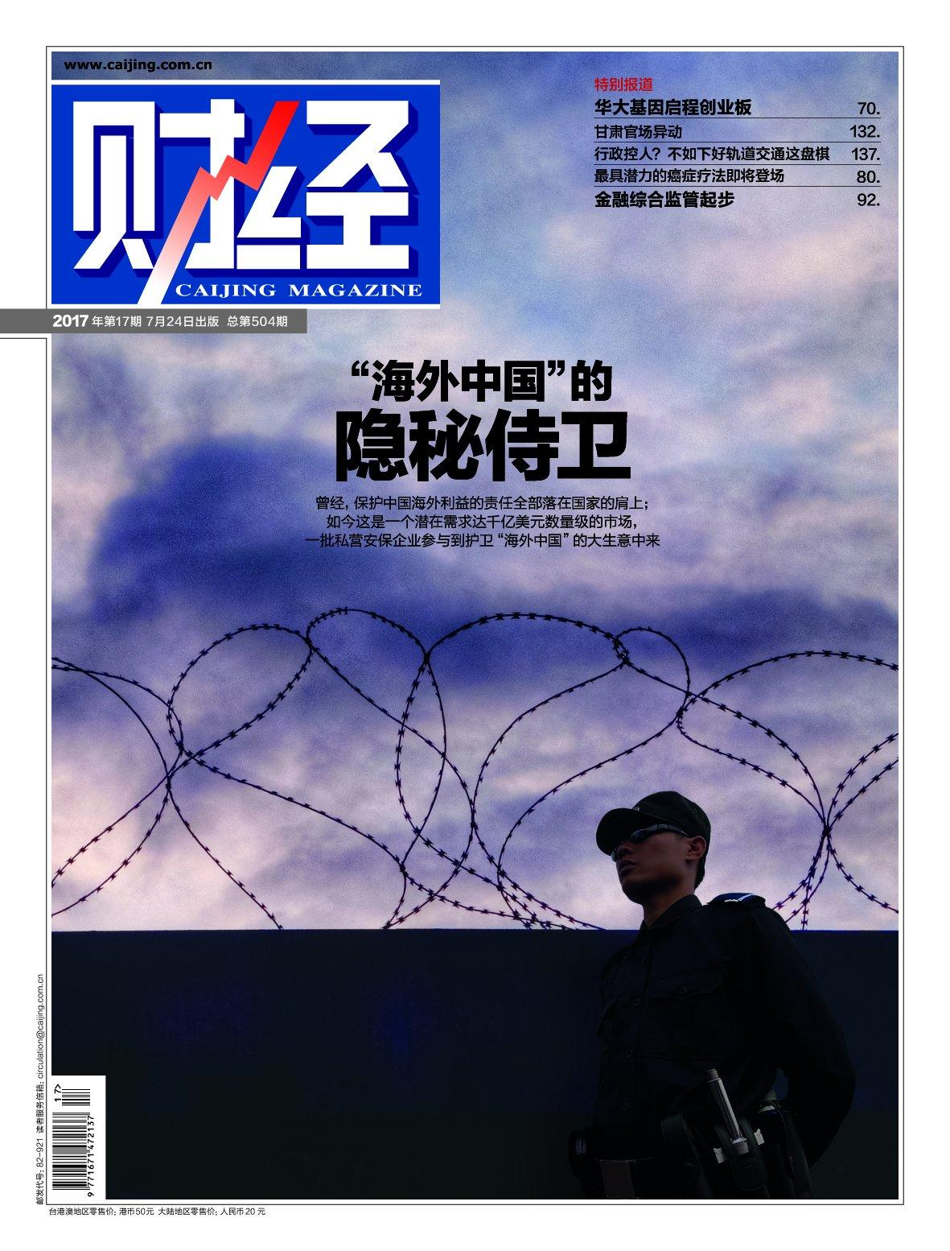
CAIJING
Caijing is an independent magazine based in Beijing that covers societal, political, and economic issues,with a focus on civil rights, public affairs, and business. Caijing was established by Hu Shuli in 1998. Caijing is published on a biweekly basis.
The magazine's circulation is limited to about 200,000, but readers are said to include many of China’s most important offices in government, finance, and academia, making it one of the country's most influential publications.

Slide 6
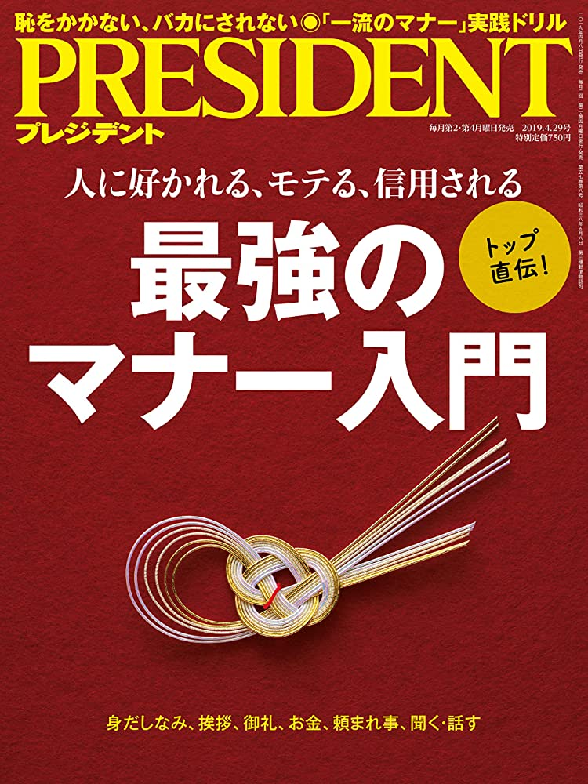
POPULAR MAGAZINES FROM JAPAN
PRESIDENT
PRESIDENT is Japan's most dynamic Business management magazine. Each issue is read by over 542,000 Japanese business decision makers working across all sectors of business and industry. PRESIDENT is well known for its authoritative and hard hitting editorial content, providing the country's senior management with a powerful insight into current business thinking as well as a look at international and national business news and trends, management, marketing and technology issues.

Slide 7

vivi
Vivi magazine is prominently popular not only in Japan but across all of East Asia, as the go to magazine for the hottest fashion and lifestyle advice. Vivi was first published in May 1983.The target age group are teens and young women 17–27 years old, with the main demographic of readers being college students and young office ladies.

Slide 8

WEEKLY SHONEN JUMP MAGAZINE
Weekly Shonen Jump is the best manga magazine from Japan, which was started by a Japanese publishing company Shueisha in 1968. It was published twice a month in the early period, and became the weekly style in 1969.
The magazine has sold over 7.5 billion copies since 1968, making it the best-selling comic/manga magazine.

Slide 9
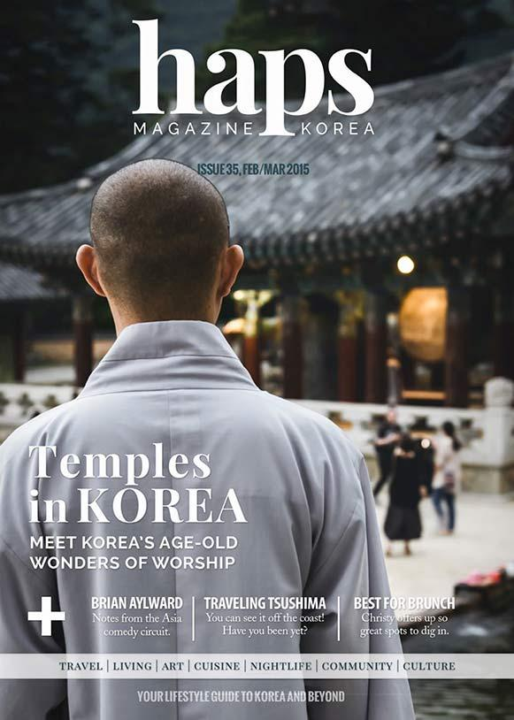
POPULAR MAGAZINES FROM SOUTH KOREA
Haps magazine
Haps Magazine, also known as "HAPS", is an English online magazine located in Busan, South Korea that focuses on lifestyle, entertainment and expat life on the Korean peninsula. It was founded in 2009 and has become one of Korea's most popular English resources for news and information.

Slide 10
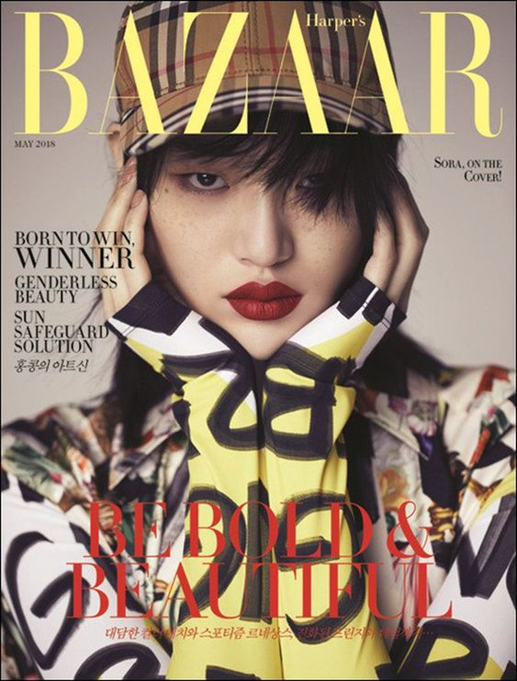
Harper’s bazaar korea
Harper's Bazaar first issued in 1867, is one of the world's leading fashion magazines, with more than 35 editions and published in 14 languages in more than 100 countries. Harper's Bazaar Korea is also known as a prestigious fashion magazine in Korea.

Slide 11
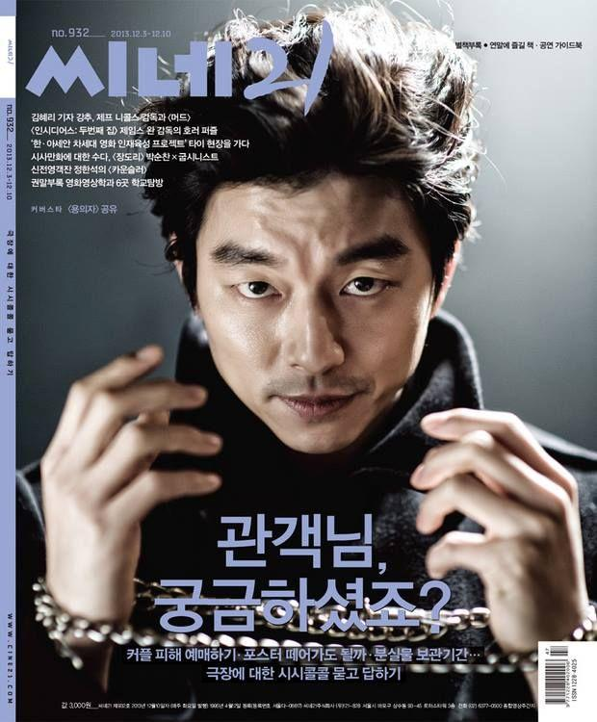
Cine21
Cine21 is a South Korean film magazine issued by Hangyeore newspaper. The magazine was first published on 24 April 1995 in Seoul, and subsequent issues have continued to be released weekly.

Slide 12
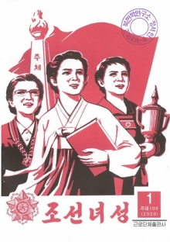
POPULAR MAGAZINE FROM NORTH KOREA
Korean Woman
Korean Woman is a monthly magazine in North Korea, founded in September 1946.The magazine is the first one to be specifically dedicated to women. It is the official media outlet of the Socialist Women's Union of Korea.

Slide 13
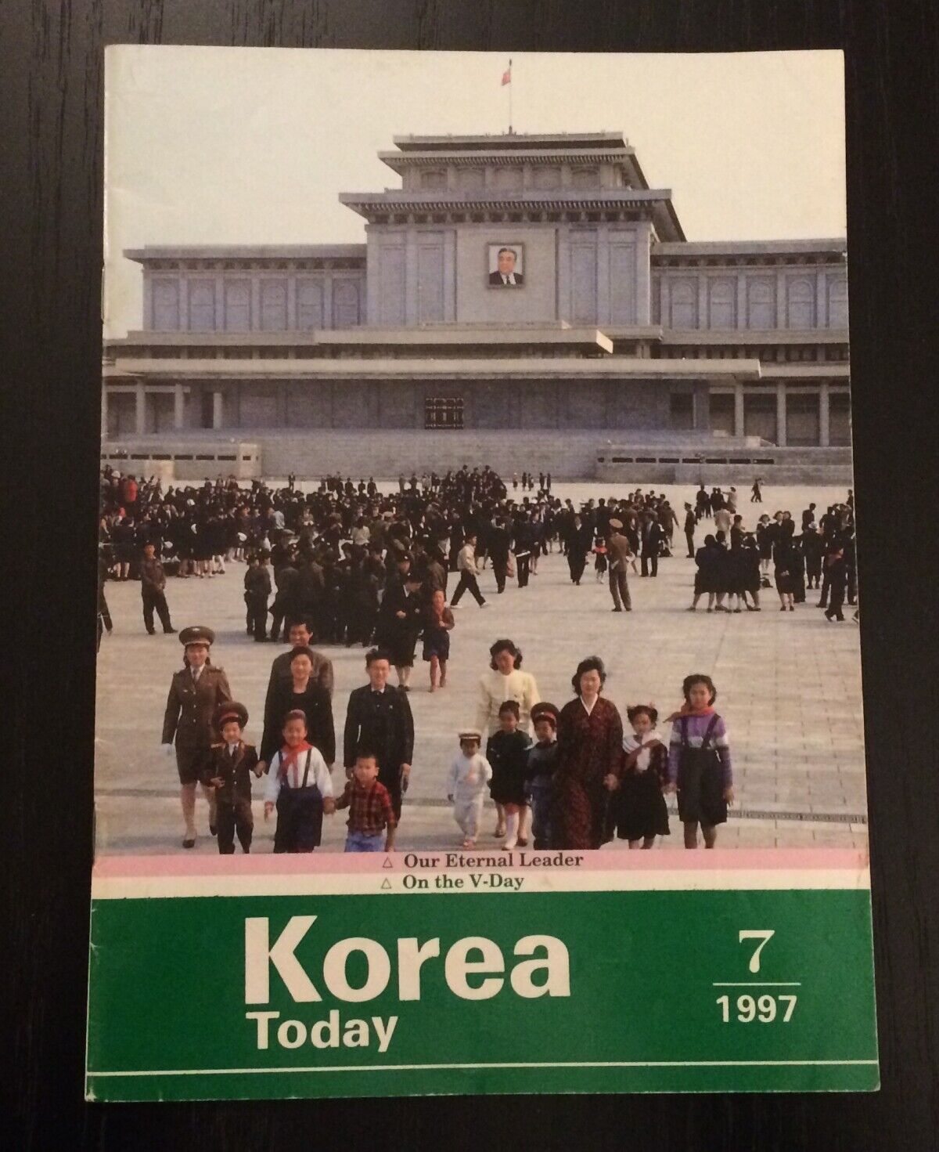
Korea Today
Korea Today, first published as New Korea, is a North Korean propaganda magazine published monthly by the Foreign Languages Publishing House in Pyongyang. The magazine focuses on cultural and industrial progress made in the country. It also publishes North Korea short stories.

Slide 14
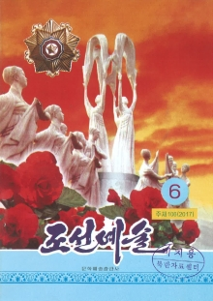
Choson Yesul
Choson Yesul is a monthly cultural and arts magazine which has been published since 1956 in Pyongyang, North Korea. It is an official media outlet of the state owned federation of the literary and artistic unions, namely the Korean Federation of Literature and Arts.

